Slide 1


Ubushakashatsi ku rwego rw'igihugu ku bitabira gahunda zo kwiga ururimi rw'ikinoruveje, amasomo mbonezamubano n'umuco ndetse na gahunda yo gutangira ubuzima bushya mu gihugu
Umuyoboro n’inama ku bitabira iyi gahunda

Slide 2

Ingingo ziri muri ubu bushakashatsi
Usubiza ibibazo bijyanye n'icyo utekereza kuri:
- Amahugurwa yururimi rw'ikinoruveje
- Gahunda yo gutangira ubuzima bushya mu gihugu
Hariho amahitamo ushobora gukuramo ibisubizo bihamye.

Slide 3

Ni kuki dutekereza ko ukwiye kwitabira?
Turashaka kumenya icyo utekereza kuri aya mahugurwa kugira ngo dushobore kuyanoza kurushaho.
Akarere cyangwa komine watujwemo bunguka ubumenyi buvuye mu bwitabire bwawe
Kugira ngo akarere cyangwa komine yawe ishobore gutanga servise n’ mahugurwa byiza kurushaho.

Slide 4

Uburyo ubu bushakashatsi bwitabirwa
Ubu bushakashatsi ntibugaragarira bose kandi ni ku bushake
Bigufata hagati y'iminota 20 na 40 gusubiza kuri ubu bushakashatsi.
Ubu bushakashatsi buboneka mu ndimi nyinshi, mu nyandiko ndetse no mu majwi.

Slide 5
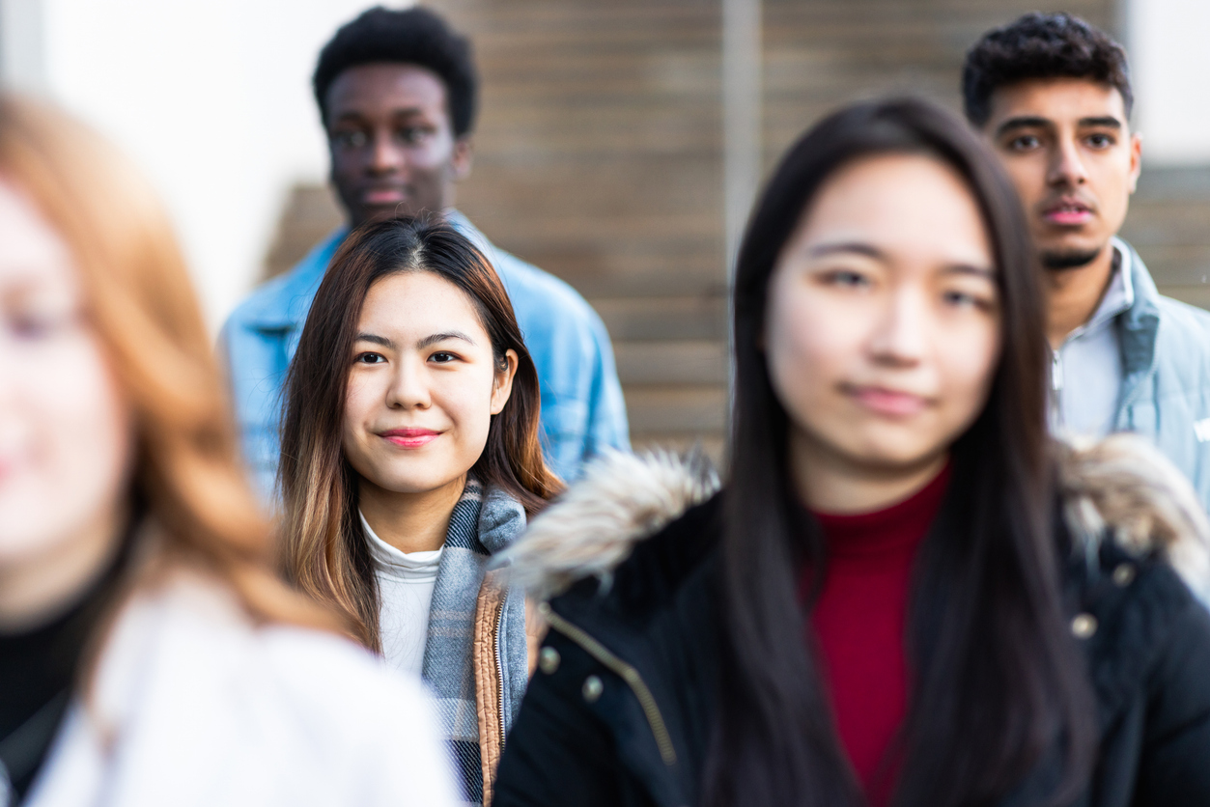
Icyitonderwa mbere y’uko utangira gusubiza ibibazo muri ubu bushakashatsi
Ugomba gusubiza ibibazo byose, ariko ushobora guhitamo «Simbizi» ​​cyangwa «Ntabwo nifuza gutanga amakuru»
Ibibazo muri ubu bushakashatsi bigomba gusubizwa rimwe gusa.
Kanda «Ibikurikira» kugira ngo ukomereze kuri buri kibazo gikurikira.
Ushobora kugerageza uburyo bw’igerageza mbere kugira ngo ushobore kwimenyereza mbere y’uko witabira ubushakashatsi nyirizina.

Slide 6


Usubiza ute ubushakashatsi?
Intambwe 1-4

Slide 7
Intambwe ya 1
Guhabwa urufunguzo rw’ikoranabuhanga kwitabira ubushakashatsi
Ukeneye urufunguzo mu buryo bw’ikoranabuhanga cyangwa kode y'ikoranabuhanga (kode-QR)
Urwo rufunguzo mu buryo bw’ikoranabuhanga (kode-QR) uruhabwa n’akarere cyangwa komine yawe

Slide 8
Intambwe ya 2
Tangira usubiza ibibazo muri ubu bushakashatsi
Koresha urufunguzo cyangwa kode-QR wahawe n'akarere.
Tunga suri kuri iri huza-murongo, kanda cyangwa usikane kode-QR

Slide 9
Intambwe ya 3
Hitamo ururimi
Kanda ku rurimi ushaka
  Ushobora guhindura amahitamo y’ururimi hagati haheruka mu bushakashatsi.
  Hanyuma kanda «Ibikurikira»

Slide 10


Intambwe ya 4
Subiza ibibazo
Soma ikibazo.
Kanda kugira ngo ushobore kumva amahitamo y’ibibazo n'ibisubizo
Shyiraho igisubizo cyawe
Hanyuma kanda «Ibikurikira»

Slide 11
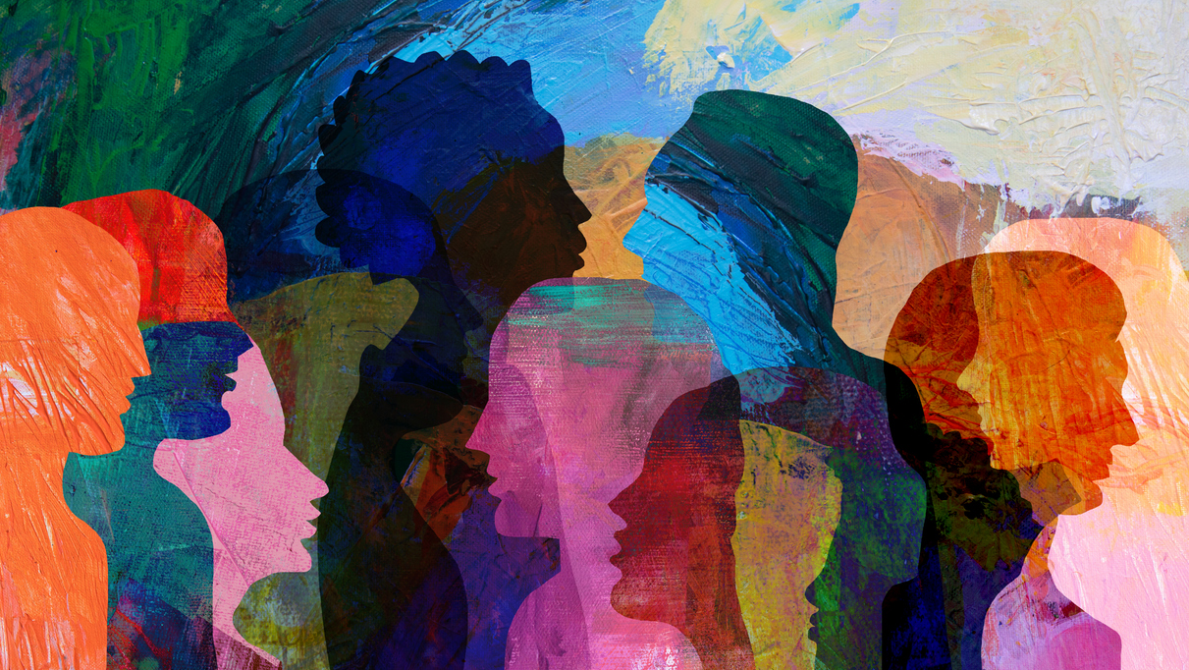
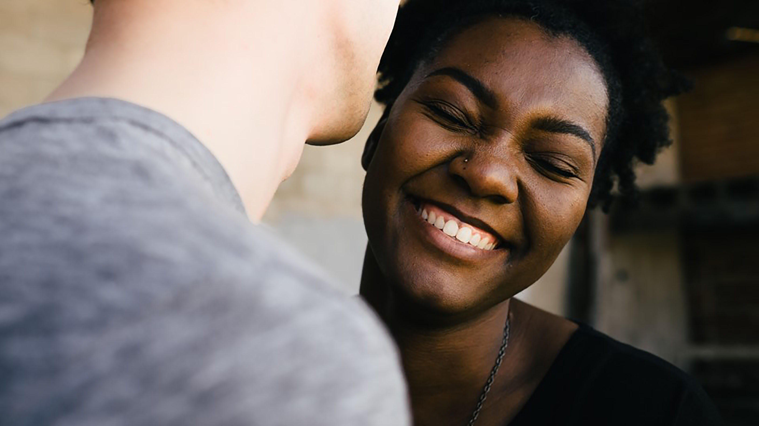
Tugushimiye ubwitabire bwawe

